Slide 1
Comeback Player Session May 25 11:00 a.m. 1:30 p.m.
Bryan Goff
Planning, Structuring
and Adapting to Your Comeback

Slide 2
Don’t believe anything that anyone tells you!
However, don’t assume that they’re
lying! They may be providing some valuable advice to you.

Slide 3
Planning your comeback:
first, define your goals
Really, now – why do I want to return to playing regularly?
Just my own personal enjoyment?
Perform as a soloist?
Perform with a group?

Slide 4
Where do I want to perform?
Community band?
Soloist in church?
Audition for an orchestra?
Gig with a big band?
Form a brass quintet?

Slide 5
What level of competency will be necessary to meet my goals?
Range and endurance?
Technique?
Transposition skills?
New repertoire to woodshed?
Good tone in exposed situations?

Slide 6
Structuring your practice: based on your goals, and
your available practice time
Claude Gordon:
A Systematic Approach
to Daily Practice
The title says it all!

Slide 7
Some suggestions:
Create a practice routine that addresses your goals.
Use a stopwatch to time each segment of your practice.
Keep a record of your practice.

Slide 8
See example of a
weekly practice log:
http://bgoff.org/Resources/PracticeLogExample.pdf

Slide 9
Some tips:
Divide practice time between various horns.
Don’t get in a rut – mix it up.
Make sure all areas are covered.
Identify areas that tend to be neglected:
Cross train like an athlete.
soft tones vs. high/loud
flexibility vs. long tones
Beta level vs. Alpha level

Slide 10
DO have a plan, but
DON’T
stick with it!
Adapting:
Yes, there will be setbacks to the original plan.
Overuse syndrome is common.

Slide 11
Specific Issues:
Mouthpiece buzz warm-up
Warm-up
Long tones vs. lip slurs
Staying in shape “on the road”

Slide 12
Breathing tips
Breath in the time of the music.
For a fuller breath, breath slower.
Breathing in a performance: because of tension we tend to breath shallow. Concentrate! Breath full!

Slide 13
Performance Planning
-similar to marathon training-
See next slide for an example of preparation for one of my recitals. Blue=my plan Red=actual

Slide 14
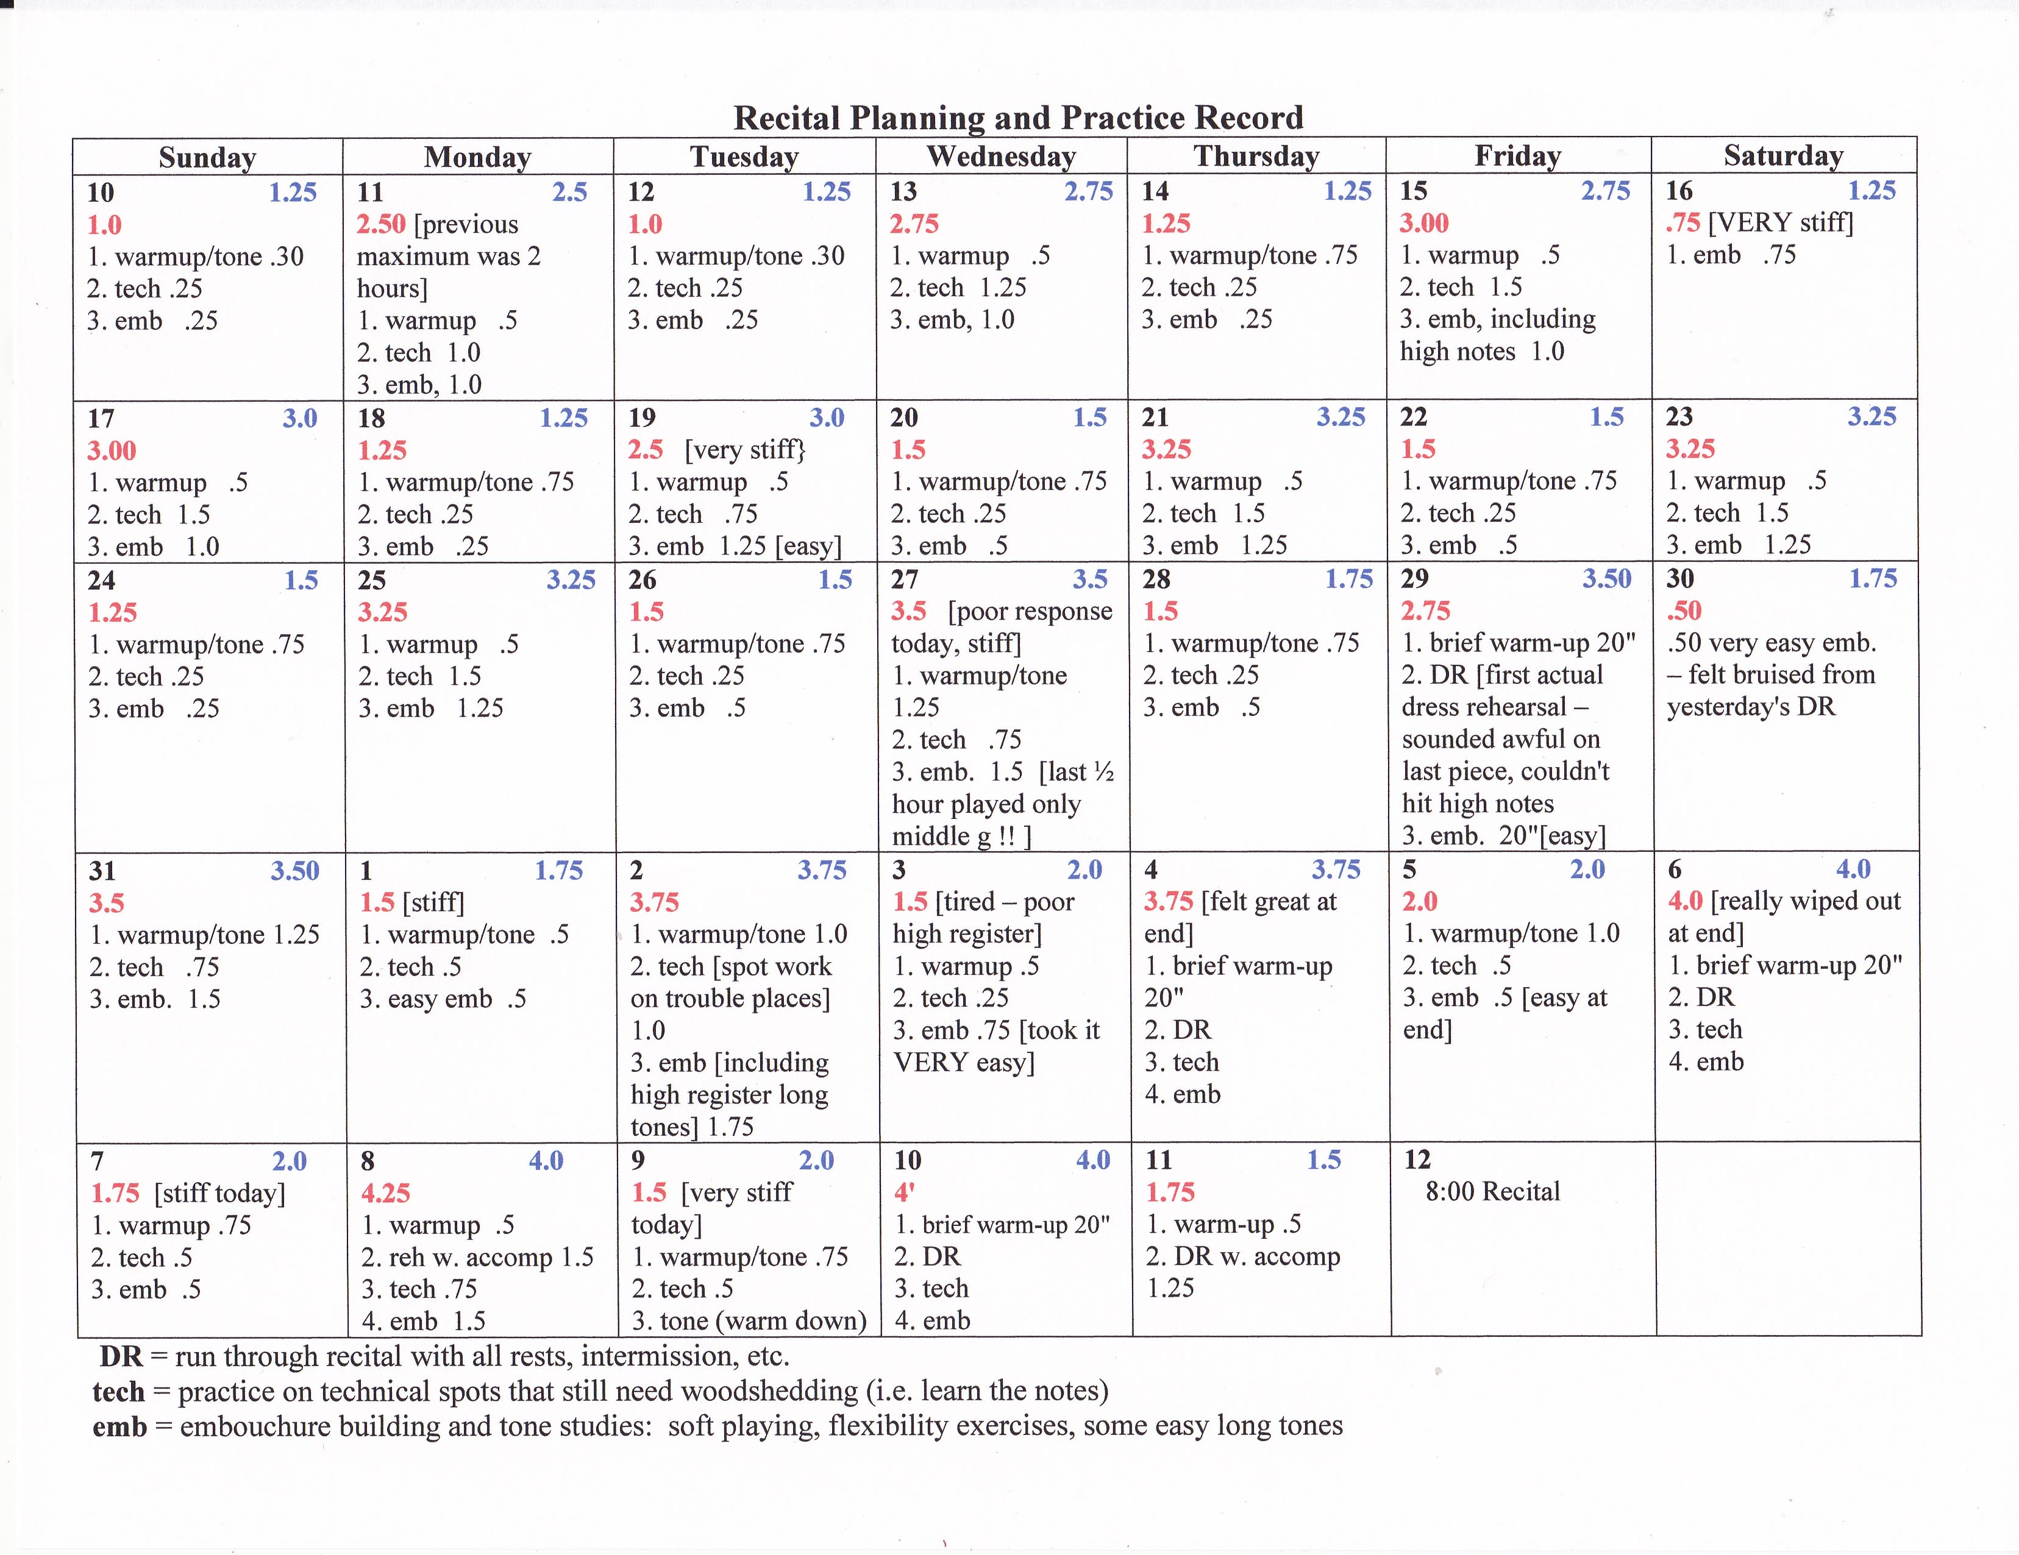

Slide 15
Make it Fun.
Play accessible (but pretty) solos
Use Smart Music accompaniments
Play accessible (but musical) etudes
Some resources may be found under the Resources tab at:
http://www.bgoff.org

Slide 16
For additional tips, see
Bryan Goff’s Trumpet Pages. Click the Trumpet Tips tab.
http://mailer.fsu.edu/~bgoff/tpt-tips/tips.html

